Slide 1

Analysis
By: Nerojan,
Edward,
Prateek,
Jialong

Slide 2



Introduction: Why Covid-19?
Compare the death rate and total confirmed case, which countries have the better medical systems to protect their population
Is there a relationship between median age of the population and death rate?
Is testing rate related to the GDP level of a country and can level of GDP of each county predict survival rate?
Is there a relationship between testing rate and reported infection rates?
Is death rate and reported infection rates correlated?

Slide 3
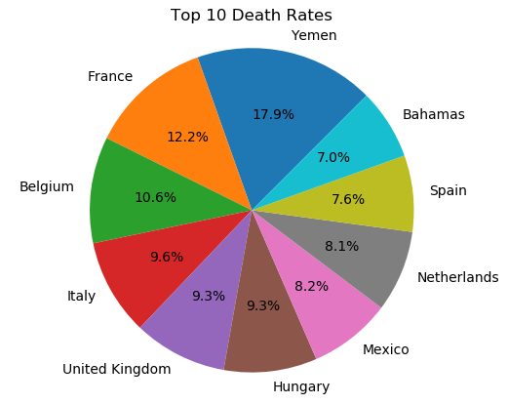

Top 10 Death Rates
Yemen has the highest death rate
Death rate concentrated in Europe
Difference between Yemen and France is almost 50% higher

Slide 4
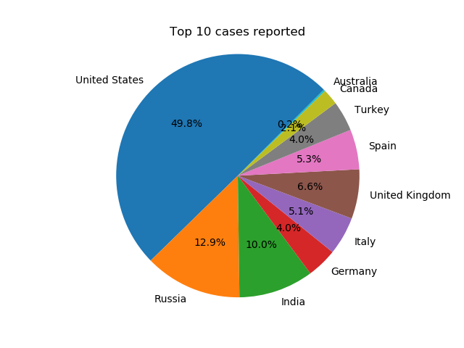

Top 10 Confirmed Cases
Highest reported cases in United States
Lowest cases in Australia and Canada

Slide 5

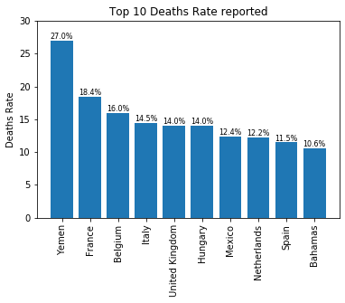
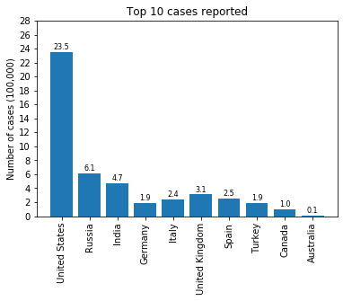
Death rate and total confirmed cases
Death Rate
Total Confirmed Cases

Slide 6
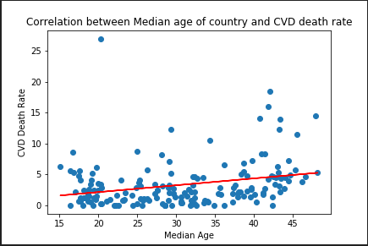

Median age of the population and death rate
R-Squared= 0.0719
Pvalue = 0.00036
Y= 0.110X -0.06113

Slide 7
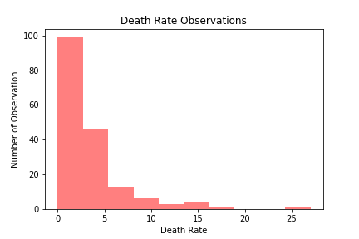

Death Rate Observations
Not normally distributed
Data is right skewed

Slide 8
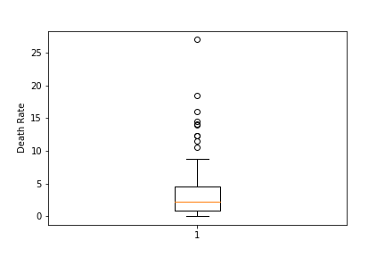

Death Rate Overall
Median= 2.223
Max = 26.995
Outliers are above 9.978

Slide 9
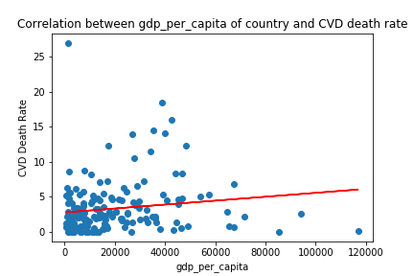
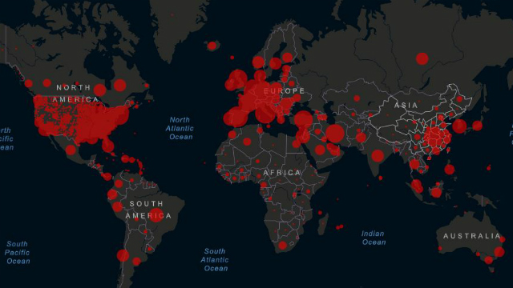
GDP Per capita of country / Death Rate
R-Squared= 0.0211
Pvalue = 0.0560
Y= 0.0000279X + 2.78537

Slide 10
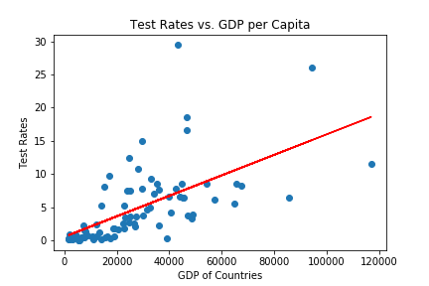

GDP Per capita of country / Test Rates
R-Squared= 0.3818
Pvalue = Close to 0
Y= 0.000154X+ 0.588554

Slide 11
Relationship between GDP / CVD Death and Test Rate
Death Rate
Test Rate

Slide 12
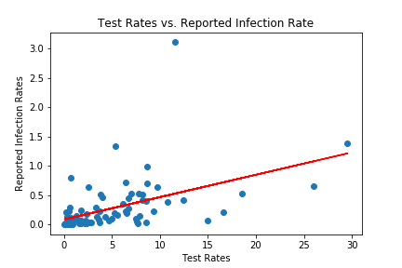

Test Rates / Reported Infection Rate
R-Squared= 0.239428
Pvalue = Close to 0
Y= 0.03814X+0.086067

Slide 13
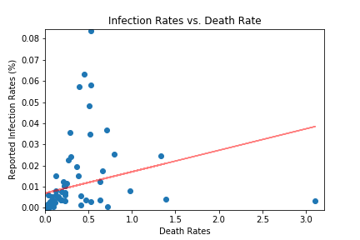
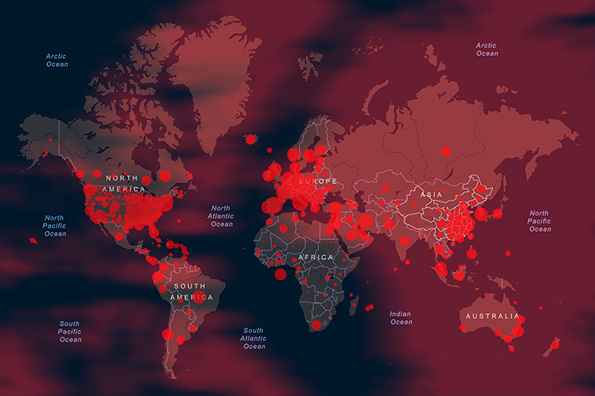
Correlation Between Median Age/ CVD Death Rate
R-Squared= 0.0722
Pvalue = 0.015
Y= 0.01014X+0.006927

Slide 14
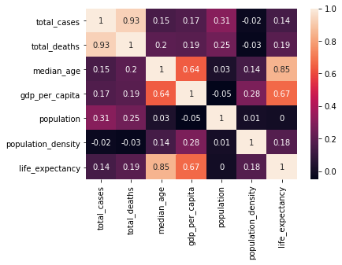

Correlation Matrix
Median age is correlated to total deaths
Population density is not an indicator of total cases

Slide 15

Conclusion
Higher the median age of the population, higher the death rate
Countries with higher GDP per capita have higher testing rates. GDP is not a predictor of survival rate
Countries with higher testing rates have higher reported infection rates
Population density is not correlated to total number of infections
The reported infection rate is not related to death rate

